Slide 1

End Semester Project Presentation - CS 498
Group Number : 23
Under the Supervision of
Dr. Partha Pakray
Associate Professor
Department of Computer Science and Engineering
National Institute of Technology Silchar
Assam - 788010, INDIA

Slide 2
Title
“ AI-Powered Voice-Guided Presentation: Revolutionizing PPT Explanations ”

Slide 3
Outline
Introduction
Motivation
Problem Statement
Literature Survey
Objectives
Methodology
Model Architecture
Result and Discussion
References

Slide 4

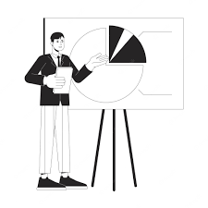
Introduction
Education's pivotal role in societal progress is being reshaped by technology, with traditional methods like PowerPoint presentations falling short in catering to diverse learning styles.
This AI-driven approach aims to automate PowerPoint explanations, fostering a more interactive learning environment.
By automating PPT explanations, it addresses need for comprehensive and adaptable learning experiences.
Fig. 1. Traditional teacher and AI based teacher [1]

Slide 5
Motivation
Traditional AI models overlook the needs of visually impaired individuals and those in economically challenged rural areas. Our project offers improved learning opportunities for them also.
Recognizing that teachers aren't always accessible, we are driven by the idea of an AI-based teacher that is available round the clock to assist students with doubts and deliver PPT-based lessons at their convenience.
Our model simplifies complex learning into an accessible and tailored educational experience by blending traditional and modern AI-based learning methods.
Our project aims to make personalized education almost cost-free, ensuring that quality learning is accessible to a broader audience.

Slide 6
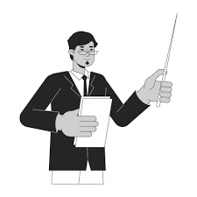
Problem Statement
Can we provide personalized learning experience (short/detailed) to the students ??
Can we make quality education accessible for the underprivileged section of society, student in remote villages and differently abled student ??
Can student access education in any time of their choice ??
Can we reduce teachers workload ??
Can we reduce Cost of Education ??

Slide 7
Literature Review
S. No. | Authors, Year & Publisher | Title | Contribution
1 | Yang Liu, Mirella Lapata, 5 Sep 2019, Institute for Language, Cognition and Computation, School of Informatics, University of Edinburgh | Text Summarization with Pre trained Encoders | The paper utilizes BERT for extractive and abstractive text summarization, introducing a document-level encoder and a specialized fine-tuning schedule. The approach achieves state-of-the-art results in both settings across on these datasets: CNNDailyMail news highlights dataset, New York Times Annotated Corpus (NYT), and XSum.
2 | Hugo Touvron, Louis Martin, Kevin R. Stone, Amjad Almahairi and 54 others,18 Jul 2023 | Llama 2: Open Foundation and Fine-Tuned Chat Models | Llama 2, an advanced dialogue-focused language model, outperforms open-source models on benchmarks. The detailed fine-tuning and safety enhancements in Llama 2-Chat encourage community involvement for responsible development.

Slide 8
Literature Review
S. No. | Authors, Year & Publisher | Title | Contribution
3 | Minghao Li, Tengchao Lv, Jingye Chen, Lei Cui, Yijuan Lu, Dinei Florencio, Cha Zhang, Zhoujun Li, Furu Wei ,21 Sep 2021, PKP Publishing Services Network Beihang University¹, Microsoft | TrOCR: Transformer-Based Optical Character Recognition with Pre-trained Models | The paper introduces TrOCR, an end-to-end text recognition approach leveraging pre-trained Transformers. It surpasses current models in printed and handwritten text recognition, offering simplicity and effectiveness, with code and models to be publicly accessible for extended research.
4 | S. Venkateswarlu, D. B. K. Kamesh, Jammalamadaka K.R. Sastry, Radhika Rani 28 Oct 2016, Indian journal of science and technology (Indian Society for Education and Environment) | Text to Speech Conversion | The paper introduces a cost-effective OCR and TTS system on Raspberry Pi, benefitting the visually impaired for auditory interaction with text images. This solution, utilizing image and voice processing modules, enhances real-time accessibility for computer interaction.

Slide 9
Literature Review
S. No. | Authors, Year & Publisher | Title | Contribution
5 | Abhijit Thikekar, Riya Menon, Saurav Telge, Gauravi Tolamatti, P. R. L. 29 Mar 2022, International Conference Computing Methodologies and Communication | Generative Adversarial Networks based Viable Solution on Dubbing Videos With Lips Synchronization | The paper proposes a method for dubbing videos using GANs for lip sync. It aims to overcome language barriers in global video content and enhance live translation in video conferencing.
6 | Itimad Raheem Ali, Ghazali Sulong, Hoshang Kolivand 31 Jul 2015,Computer and Information Science (Canadian Center of Science and Education) | Realistic Lip Syncing for Virtual Character Using Common Viseme Set | The paper introduces a new lip synchronization algorithm for realistic applications, automating the process within 3D Alias Wavefront Maya 4 software. It provides technical details and conclusions about achieving accurate lip synchronization.

Slide 10
Objectives
Our main objective is to develop advanced techniques for automatic PowerPoint summarization and convert it to high-quality text-to-speech.
This research aims to address the following sub objectives:
Content Abstraction : To extract information from PPTs while keeping it coherent.
PPT Summarization : To turn complex PPTs into concise summaries that convey meaning.
Text-to-Speech Conversion: To transform summarized text into natural-sounding speech.
User Customization: To allow users to select personalized voices as tutor.
User Interface: To create an easy-to-use interface for broader accessibility.
Real-world Applicability: To help visually impaired individuals and improve education for them.

Slide 11
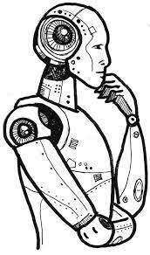
Methodology
The methodology we followed involves a carefully thought-out process to make PowerPoint explanations really clear and engaging using Artificial Intelligence, which makes learning fun.
Data Extraction and Content Generation: The system takes PPT and extracts text, images, and multimedia and generates the content for the ppt presenter using AI.
AI-Powered Auditory Explanations : Converts summarized content into spoken language, enhancing accessibility for visually impaired learners and improves auditory learning
Interactive Platform Integration : A user-friendly platform lets students to learn concepts about the PPT and the system quickly answers them in real time.

Slide 12


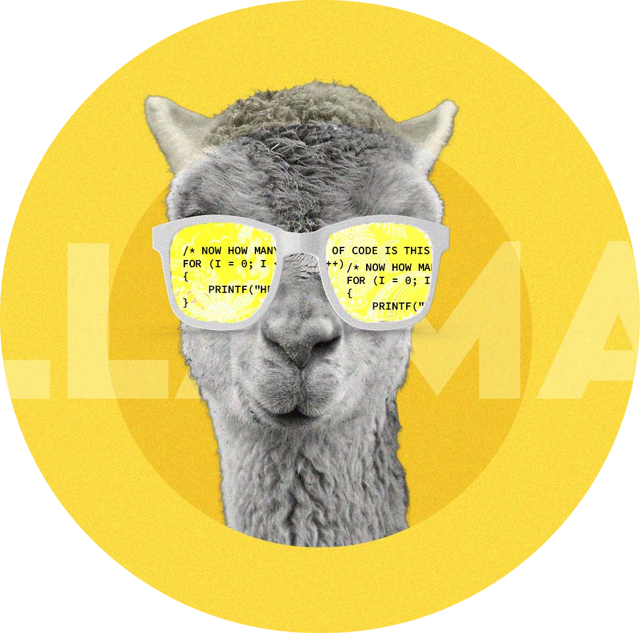
Content Generation using gen AI
Utilized python-pptx library to extract content from PowerPoint (PPT) files.
Employed fine-tuned meta-llama/Llama-2-7b-chat-hf developed by Meta for dialogue-based text generation, specifically, for generating slide explanations
Summarized generated explanations using facebook/bart-large-cnn model, showing promising results in text summarization.

Slide 13
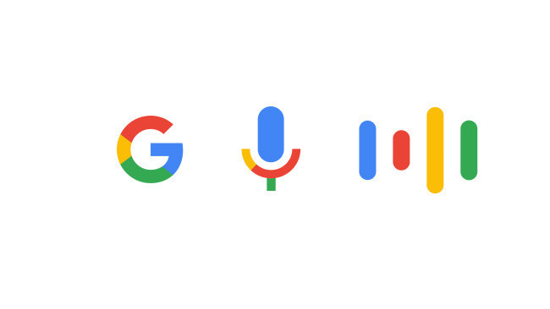
Text-to-Speech Integration
The integration of Google Text-to-Speech API emerges as a pivotal component, providing an unparalleled auditory experience.
The API's comprehensive features, wide language support, and ability to create a unique brand voice make it a preferred choice.
Google's text-to-speech based on WaveNet outperforming other synthetic voices.
WaveNet generates speech with more natural emphasis and inflection on syllables, phonemes, and words.

Slide 14
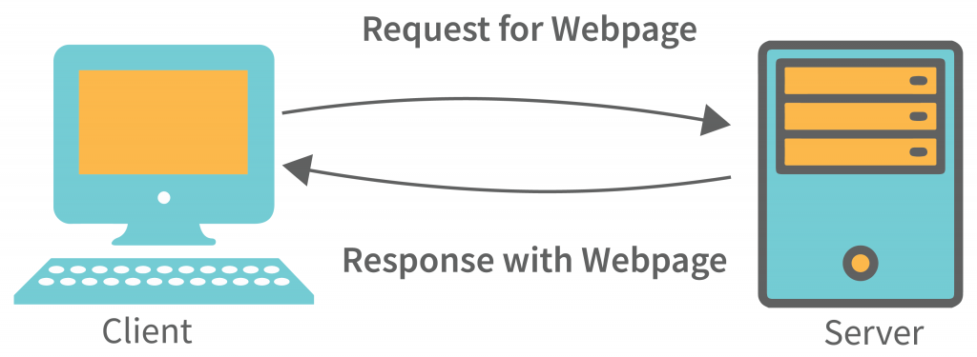


Web Integration
Web application designed with a client-server model.
React Frontend
Provides an interactive and intuitive user interface.
Routes in React Framework:
- /home
- /upload
- /presentation
Flask Server
Meticulously crafted endpoints for specific functionalities
Endpoints in Flask server:
/generate_audio:
- /generate_content

Slide 15
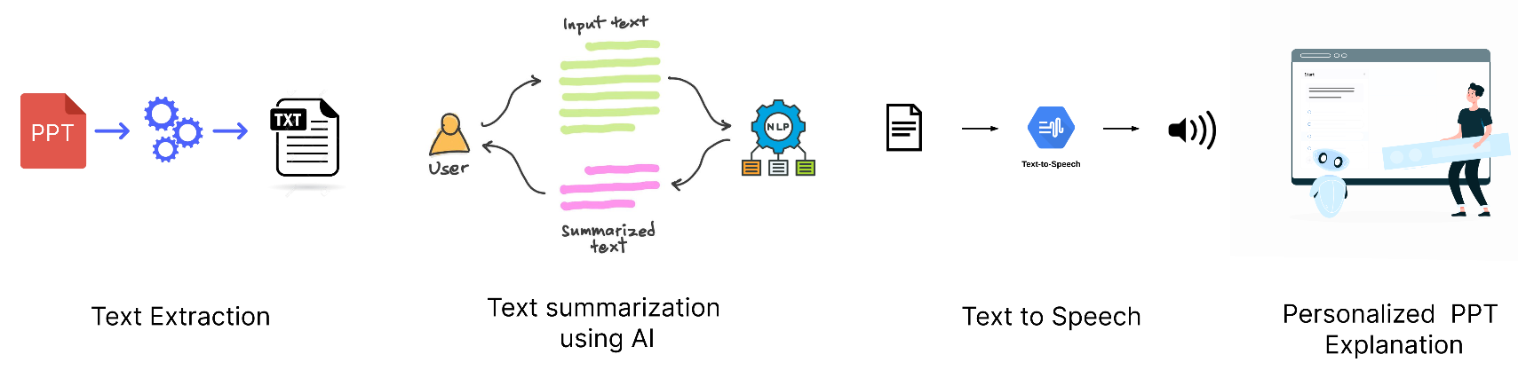
Project Architecture
Fig. 2. Workflow of this project

Slide 16
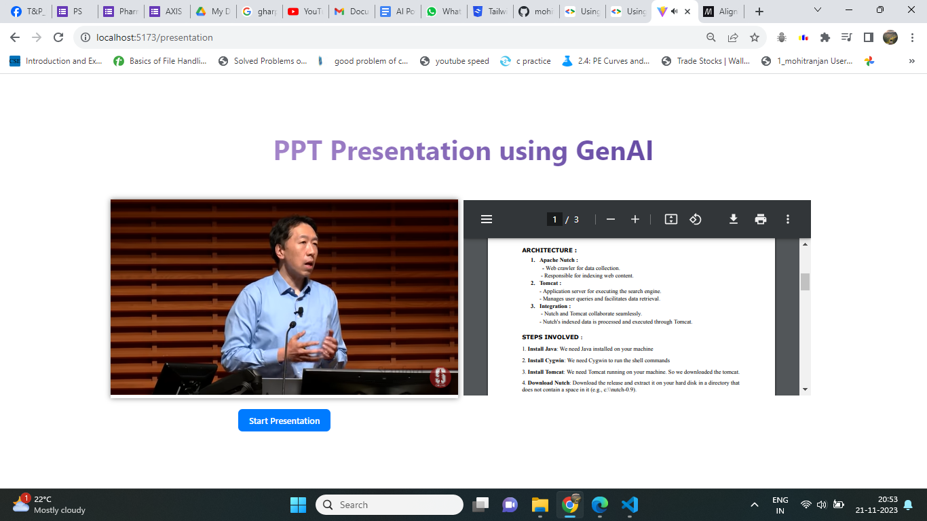
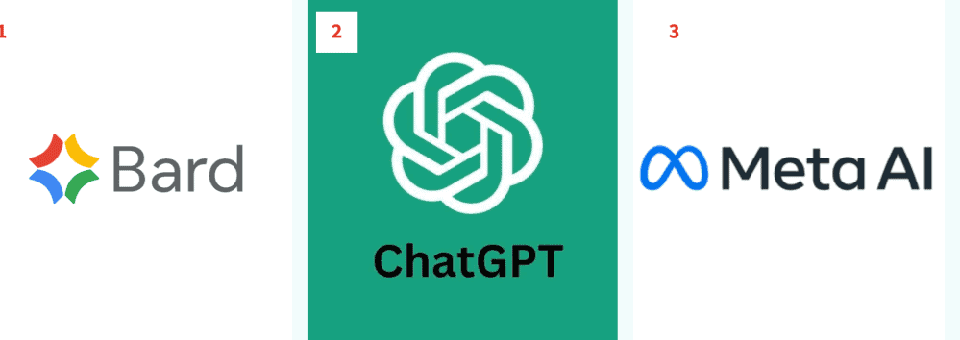
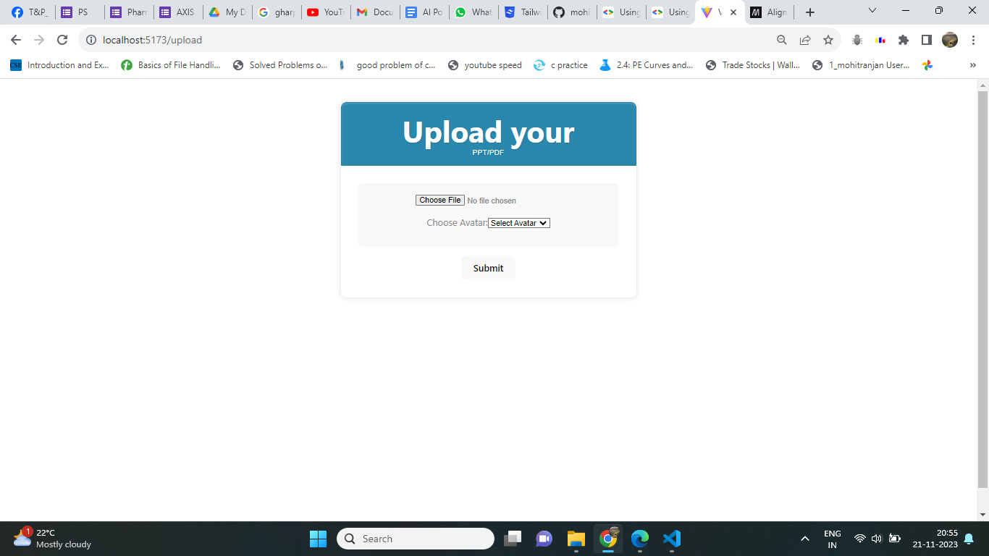
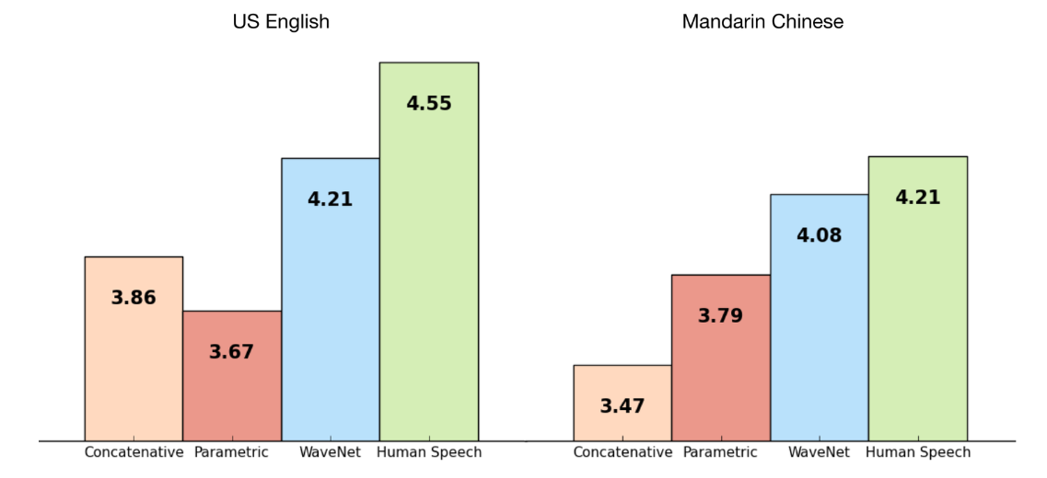
Result and Discussion
Fig 1 : Demo of ppt presentation
Fig 3 : Comparison of Bard vs ChatGPT vs LLama 2
Fig 2 : /upload route to upload ppt
Fig 4 : Google tts outperforming others

Slide 17
Project Timeline
( Aug - Sep )
( Jan - Mar )
Background Study
Start with Frontend
Authentication and authorization
Mid sem project presentation
Lips Synchronisation
Interactive Doubt Resolution
customization on ppt summarisation
Mid sem project presentation
01
03
2023
2024
02
04
( Oct- Dec )
( Apr- May )
Customised voice integration
Customised avatar integration
Completion of Project
Text summarisation model
Text to Speech model
UI integration with Above model
End sem project presentation
Fig. 3. Project Timeline

Slide 18
References
[1] Yang, Liu., Mirella, Lapata. (2019). “Text Summarization with Pre Trained Encoders”. 3728-3738. doi: 10.18653/V1/D19-1387
[2] Minghao, Li., Tengchao, Lv., Lei, Cui., Yijuan, Lu., Dinei, Florencio., Cha, Zhang., Zhoujun, Li., Furu, Wei. (2021). “TrOCR: Transformer-based Optical Character Recognition with Pre-trained Models. arXiv: Computation and Language”,
[3] S., Venkateswarlu., D., B., K., Kamesh., Jammalamadaka, K.R., Sastry., Radhika, Rani. (2016). “Text to Speech Conversion. Indian journal of science and technology”, 9(38), 1-3. doi: 10.17485/IJST/2016/V9I38/102967
[4] Itimad, Raheem, Ali., Ghazali, Sulong., Hoshang, Kolivand. (2015). “Realistic Lip Syncing for Virtual Character Using Common Viseme Set. Computer and Information Science”, 8(3), 71-82. doi: 10.5539/CIS.V8N3P71
[5]Fang, Wei, TianXiao Jiang, Ke Jiang, Feihong Zhang, Yewen Ding, and Jack Sheng. "A method of automatic text summarisation based on long short-term memory." International Journal of Computational Science and Engineering 22, no. 1 (2020): 39-49.
[6]S, Keerthana., R, Venkatesan. (2020). “Abstractive Text Summarization using Seq2seq Model. International Journal of Computer Applications”, 176(33), 24-26. doi: 10.5120/IJCA2020920401
[7] Touvron, Hugo, Louis Martin, Kevin Stone, Peter Albert, Amjad Almahairi, Yasmine Babaei, Nikolay Bashlykov et al. "Llama 2: Open foundation and fine-tuned chat models." arXiv preprint arXiv:2307.09288 (2023).

Slide 19
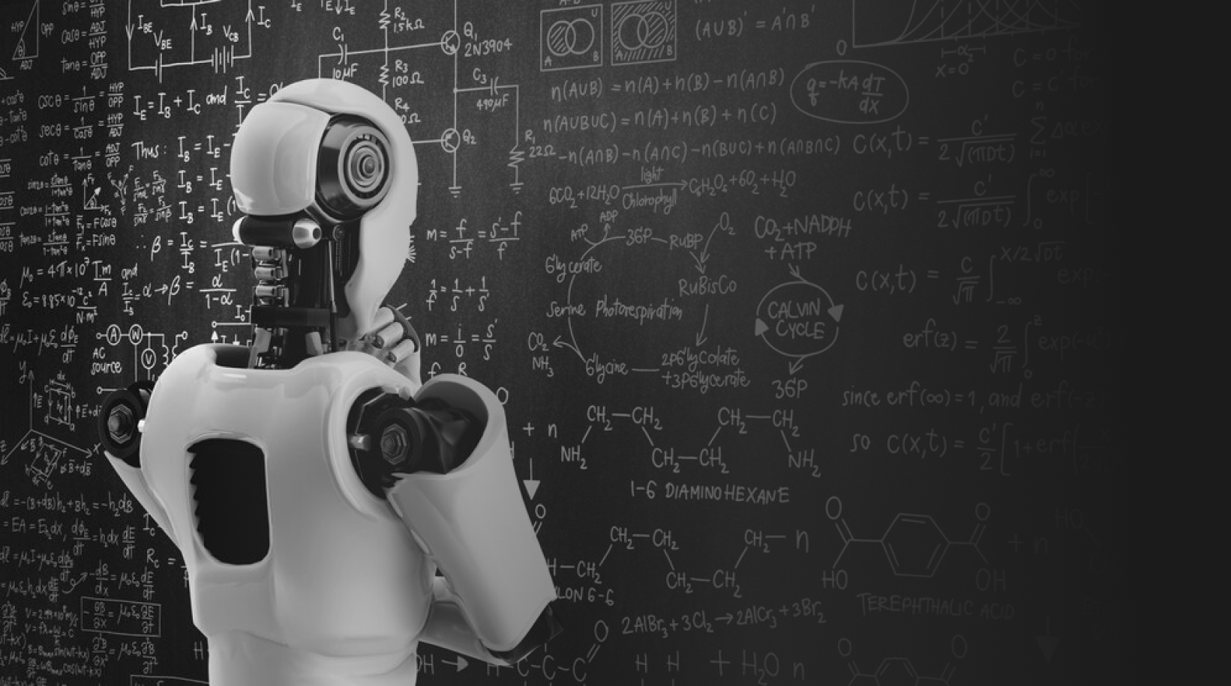
THANK YOU

